Slide 1
Icollab: A Collaborative Platform
Presented by: Yash Gabani (22CEUOS137)
Meet Antala (22CEUOS096)

Slide 2
Introduction
Icollab is a team collaboration platform designed for organizations and teams to communicate and manage workflows efficiently.
It includes workspaces, channels, messaging, video calls, and integrations.

Slide 3
Purpose of Icollab
Effective Team Communication: Helps teams stay connected in real-time.
Improved Workflow: Organizes discussions into channels for better project management.
All-in-One Collaboration: Combines messaging, video calls and integrations.

Slide 4
Product Scope
Create Workspaces & Channels – Organize communication based on teams or projects.
Real-time Messaging – Instant group messaging within channels.
AI-Based Message Summarization – Summarizes long conversations for quick understanding.

Slide 5
Overall Description
Web-based platform built using the MERN stack (MongoDB, Express.js, ReactJS, Node.js).
Integrates with third-party tools like GitHub.
Uses WebRTC for real-time communication (video calls).
Summarization of lengthy conversations for quick insights.
It helps users catch up on missed discussions.

Slide 6
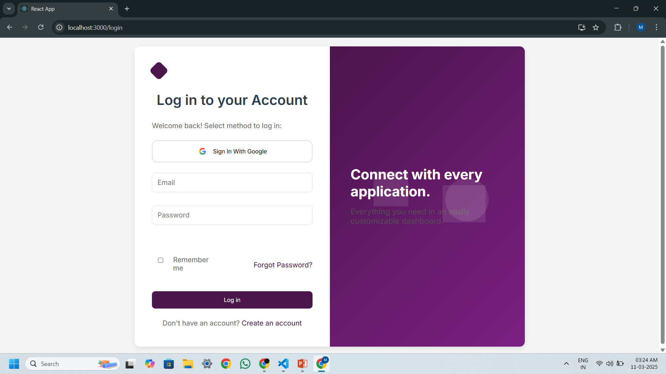
Authentication

Slide 7
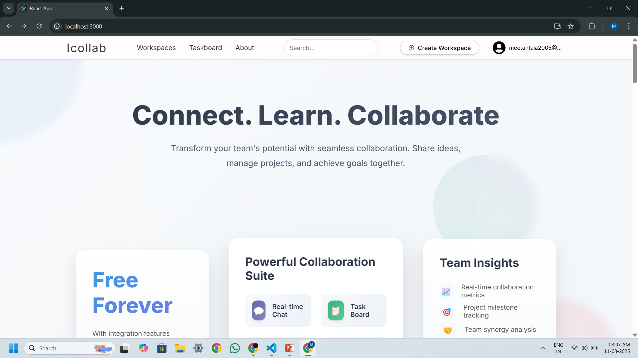
Homepage

Slide 8
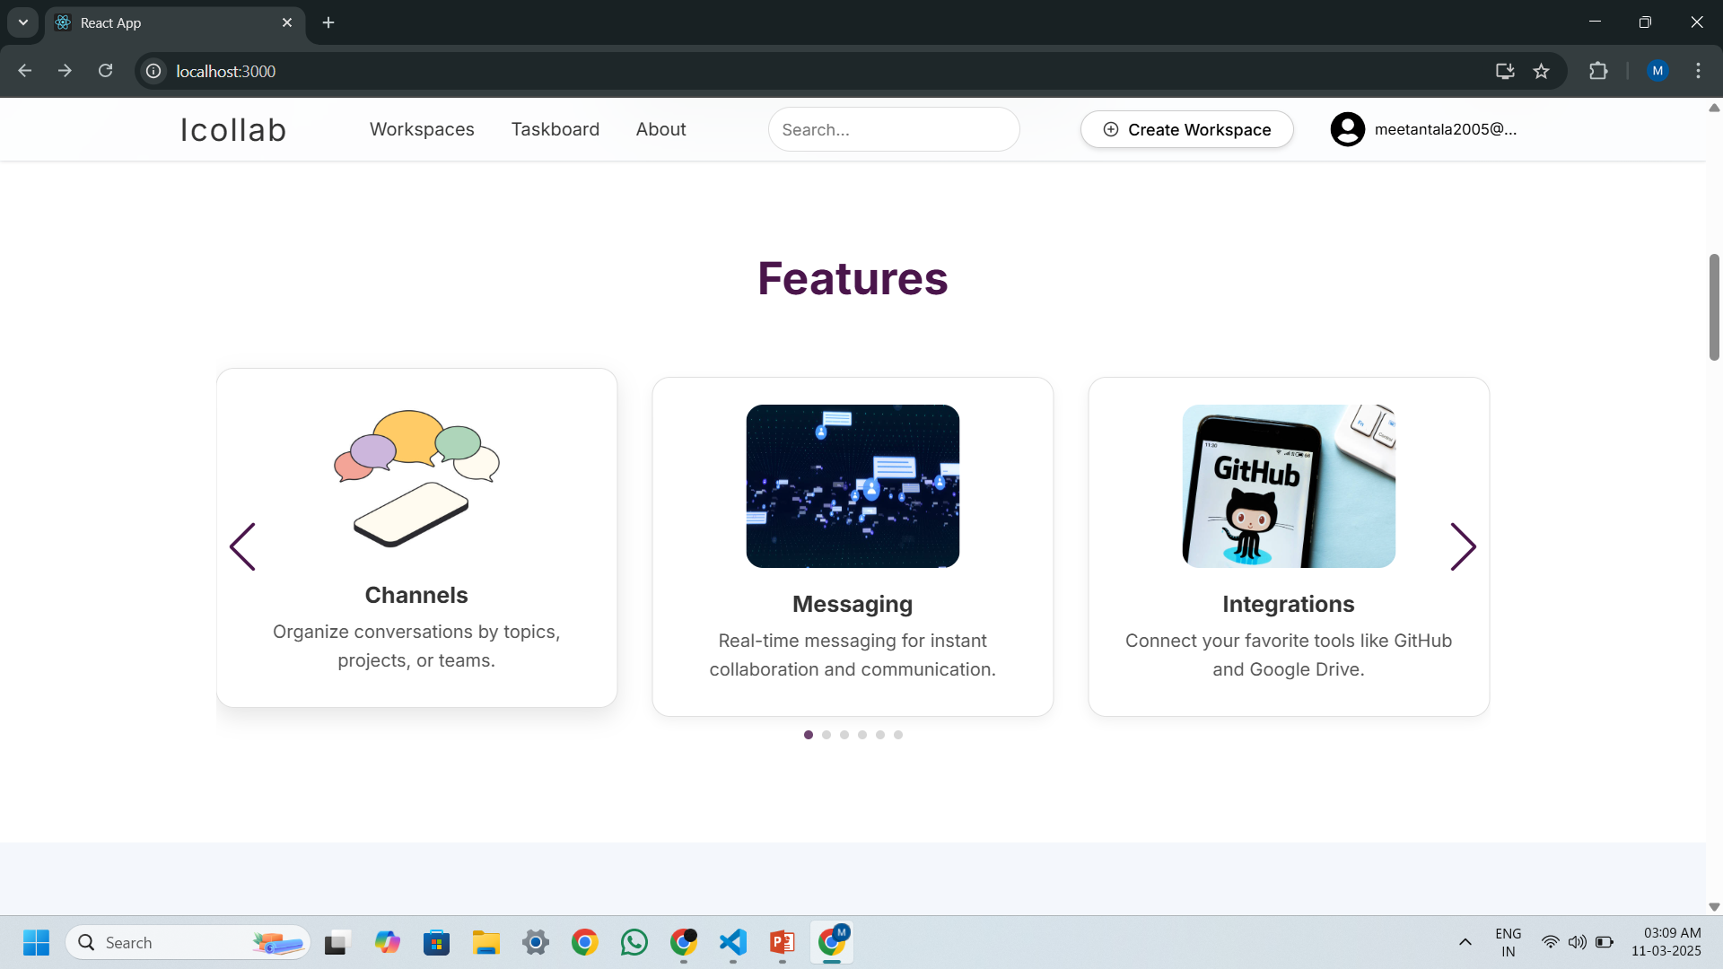
Homepage

Slide 9
System Features - Workspaces & Channels
Users can create or join workspaces for different teams.
Different Channels for collaboration.
Customizable workspace settings for better organization.

Slide 10
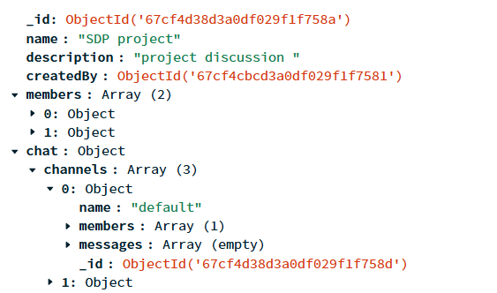
System Features - Workspaces & Channels

Slide 11
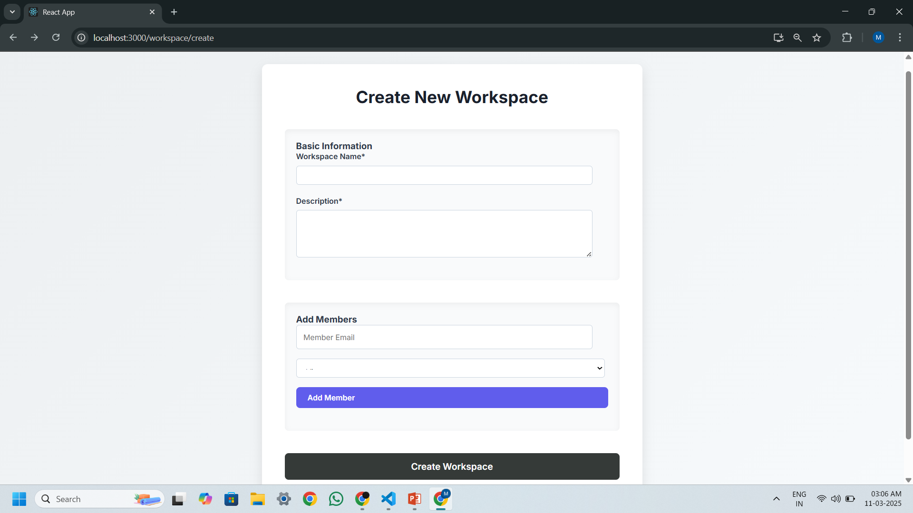
System Features - Workspaces & Channels

Slide 12
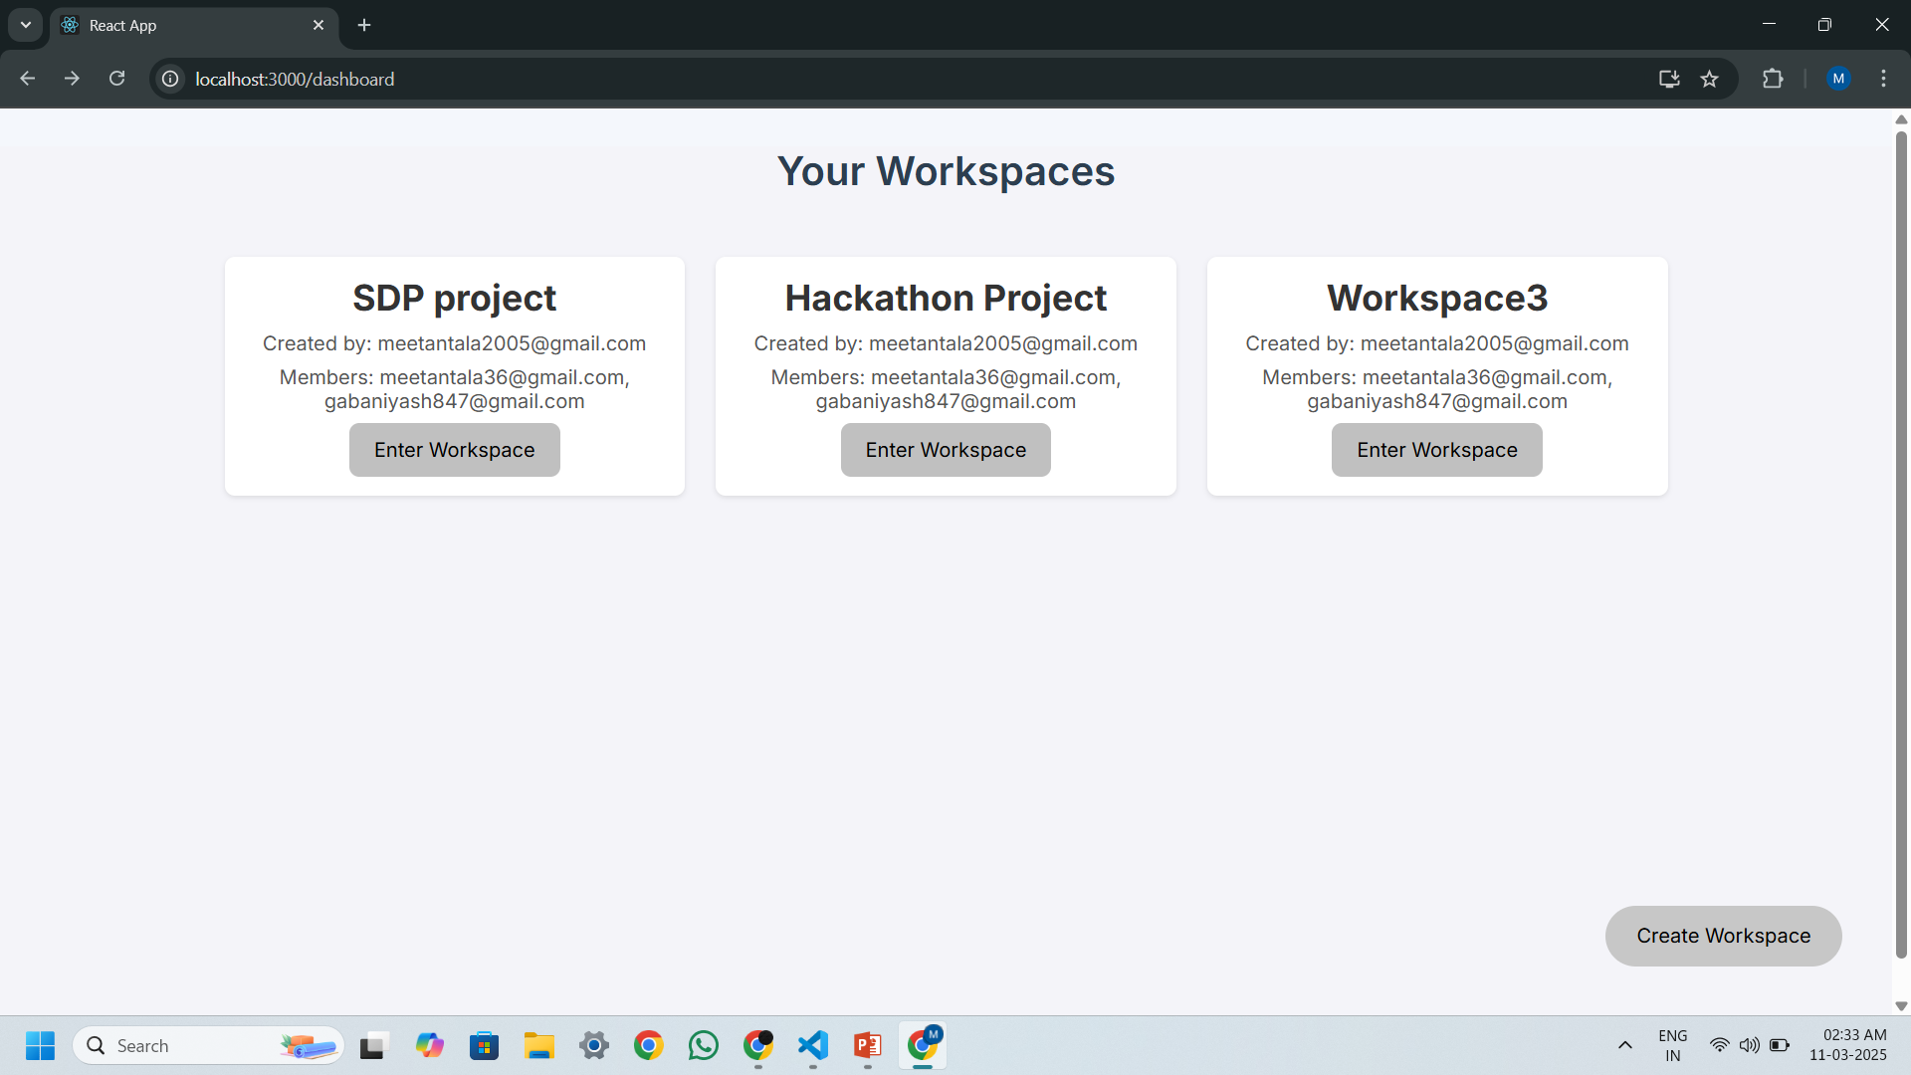
System Features - Workspaces & Channels

Slide 13
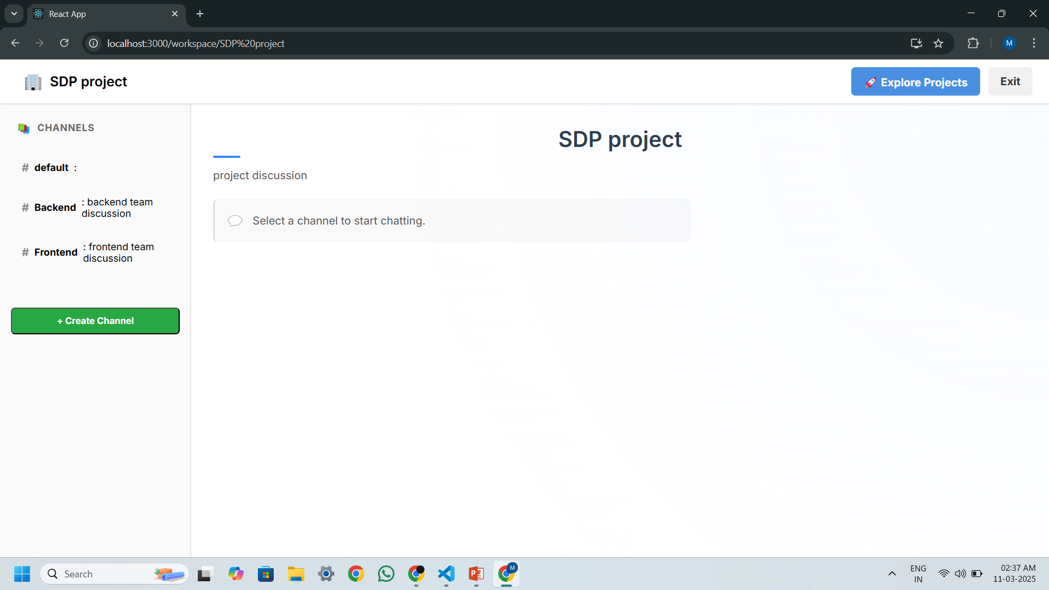
System Features - Workspaces & Channels

Slide 14
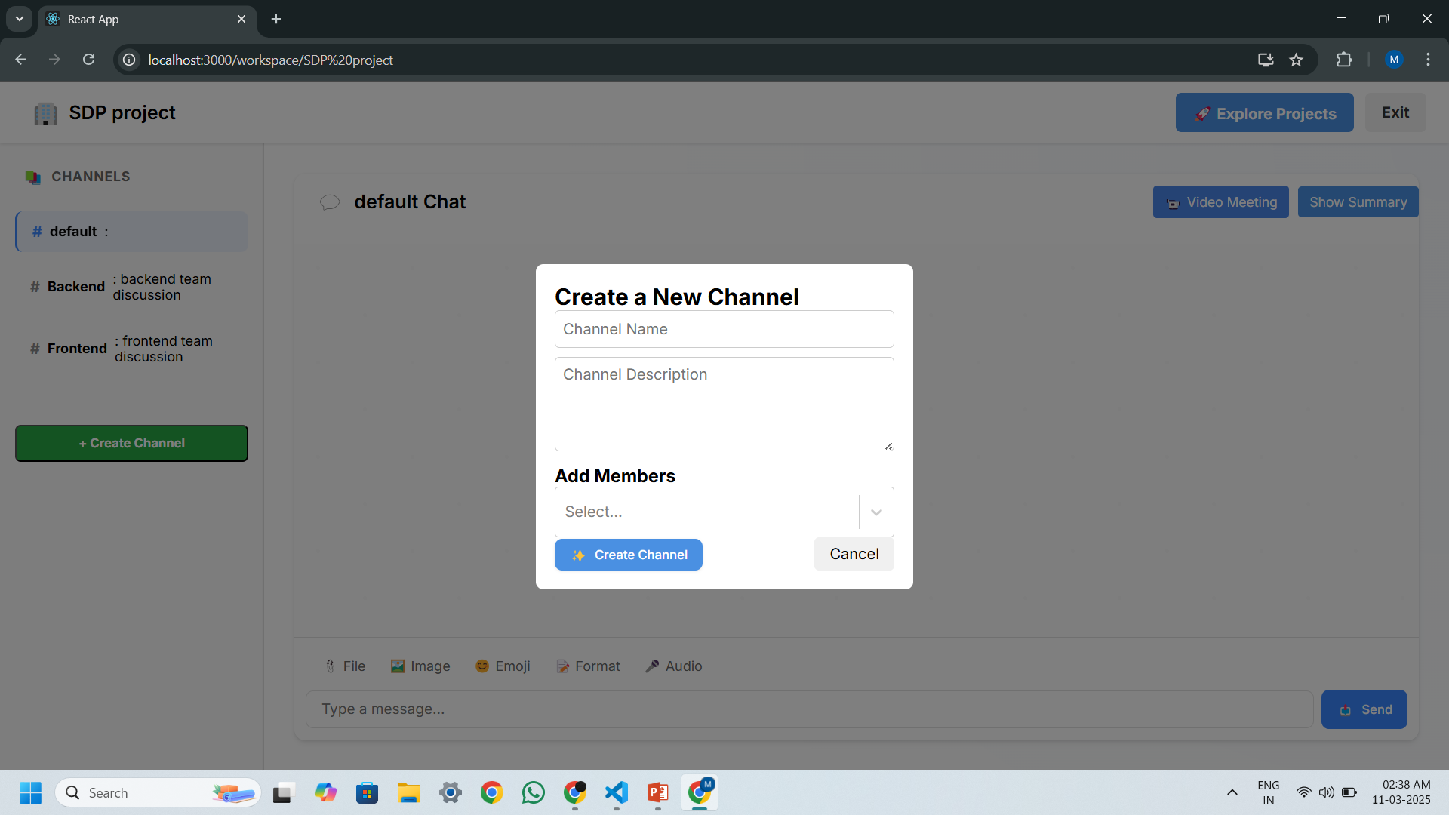
System Features - Workspaces & Channels

Slide 15
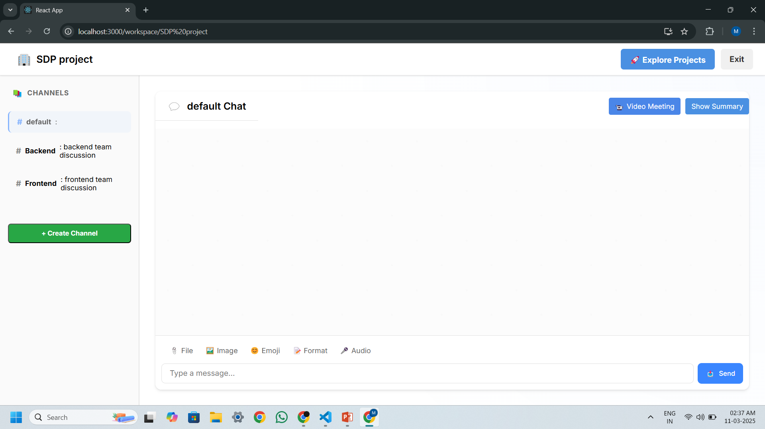
System Features - Workspaces & Channels

Slide 16
System Features - Messaging
Instant text-based communication within channels or private messages.
Real-time updates using WebSockets.

Slide 17
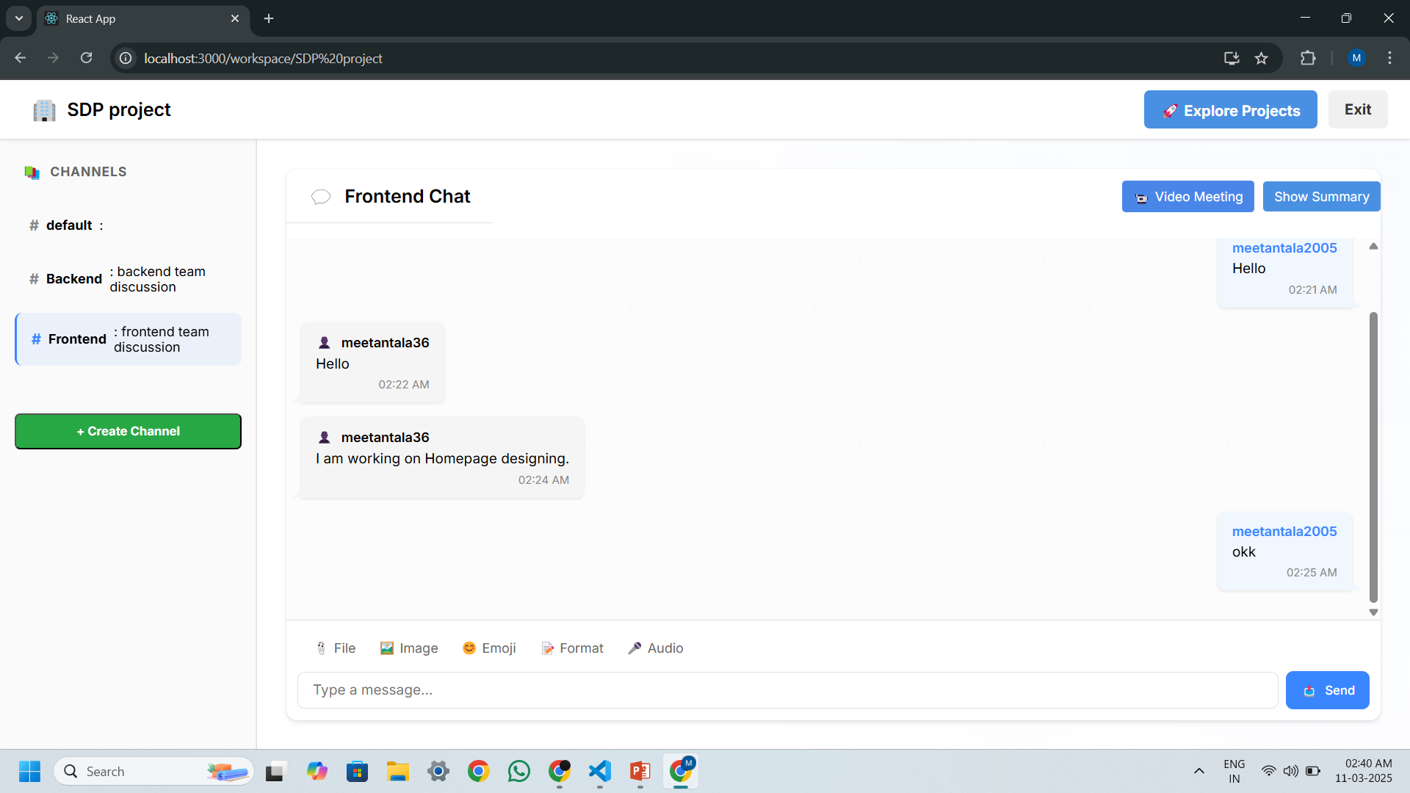
System Features - Messaging

Slide 18
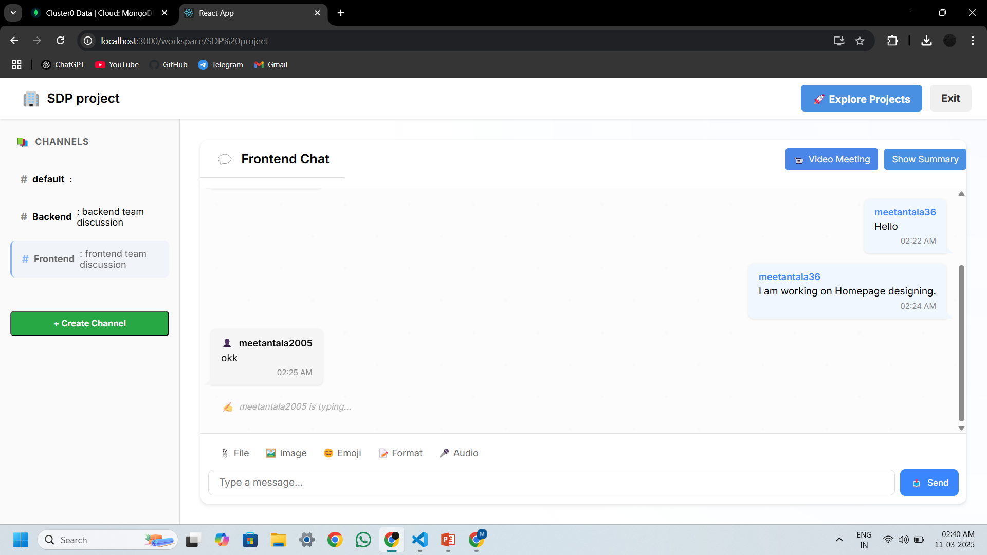
System Features - Messaging

Slide 19
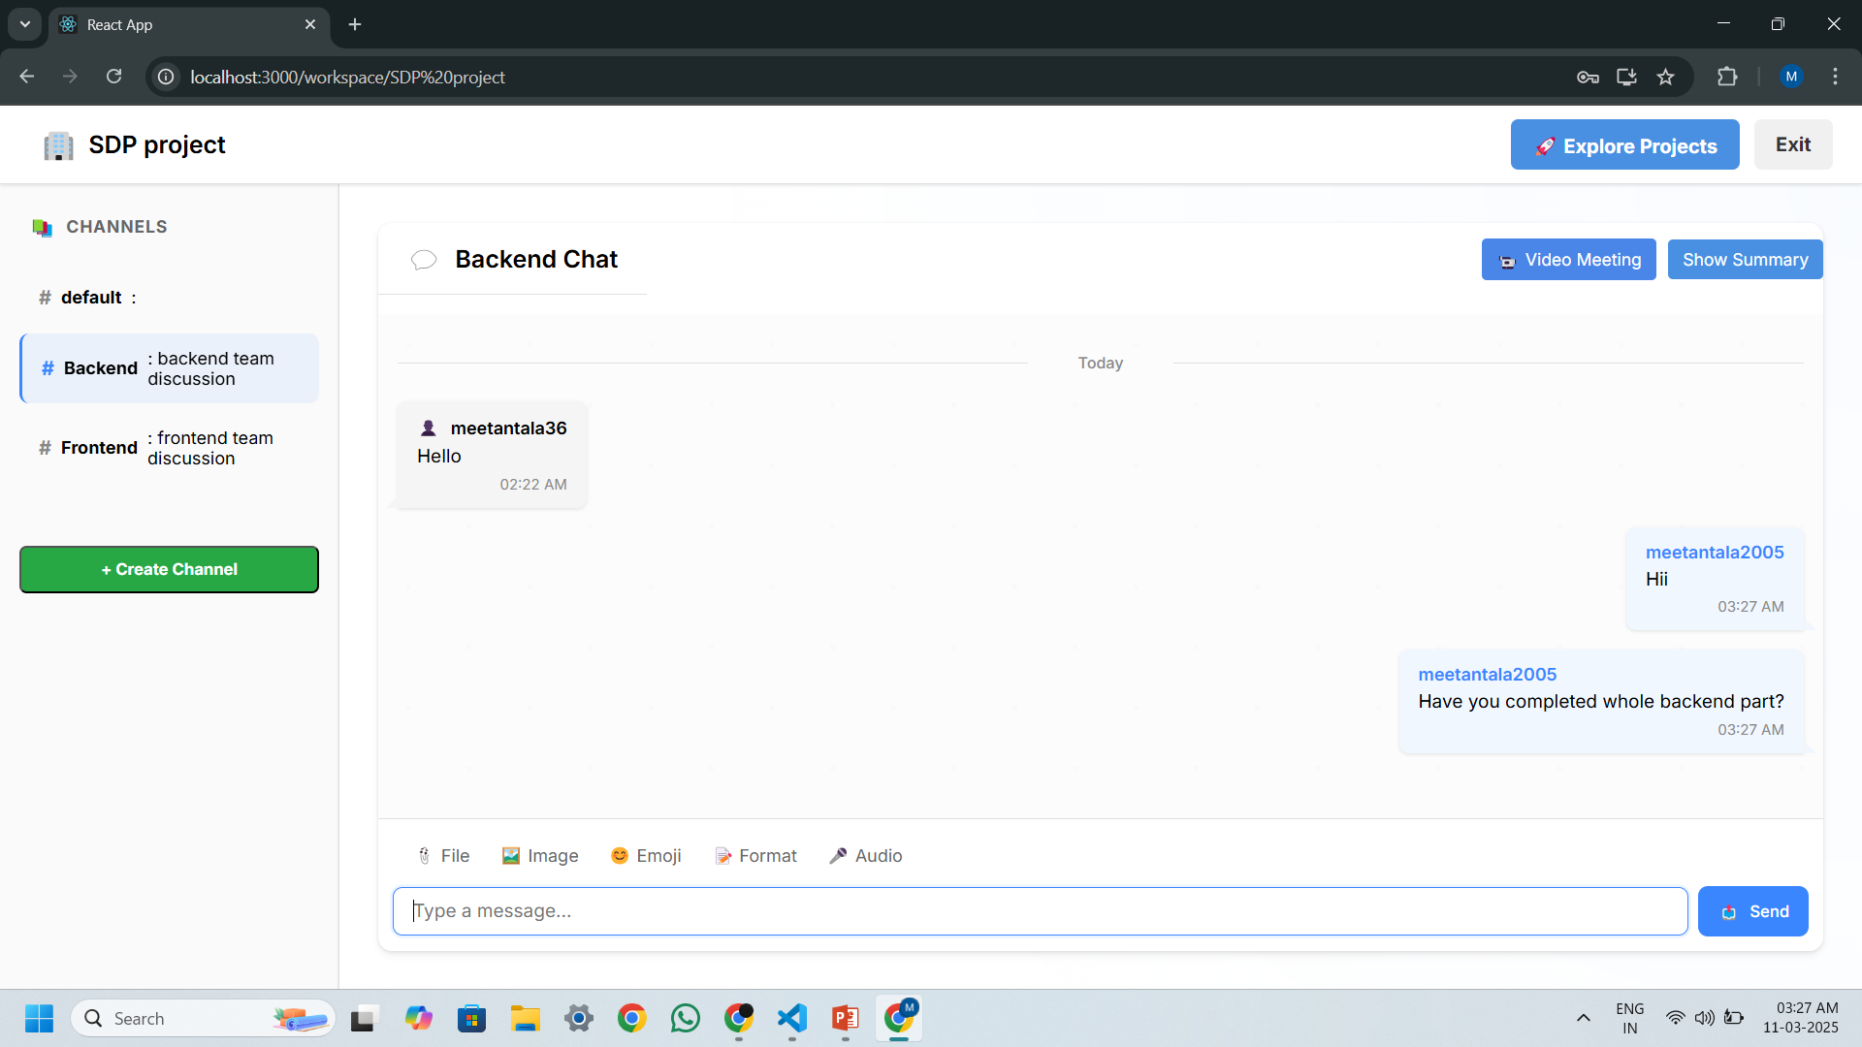
System Features - Messaging

Slide 20
System Features - Video Calls
Uses WebRTC technology for smooth real-time video calls.
Supports One-on-One and Group Video Calls.

Slide 21
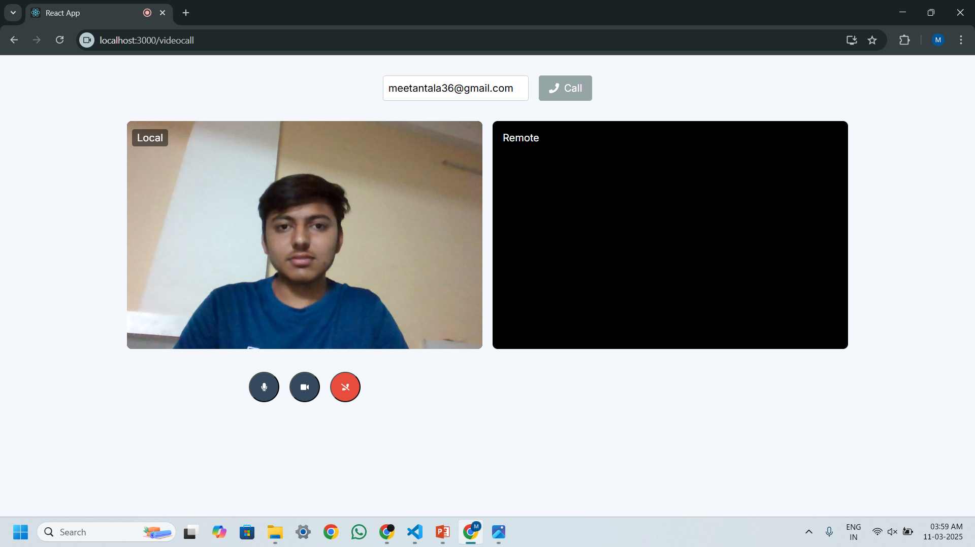
System Features - Video Calls

Slide 22
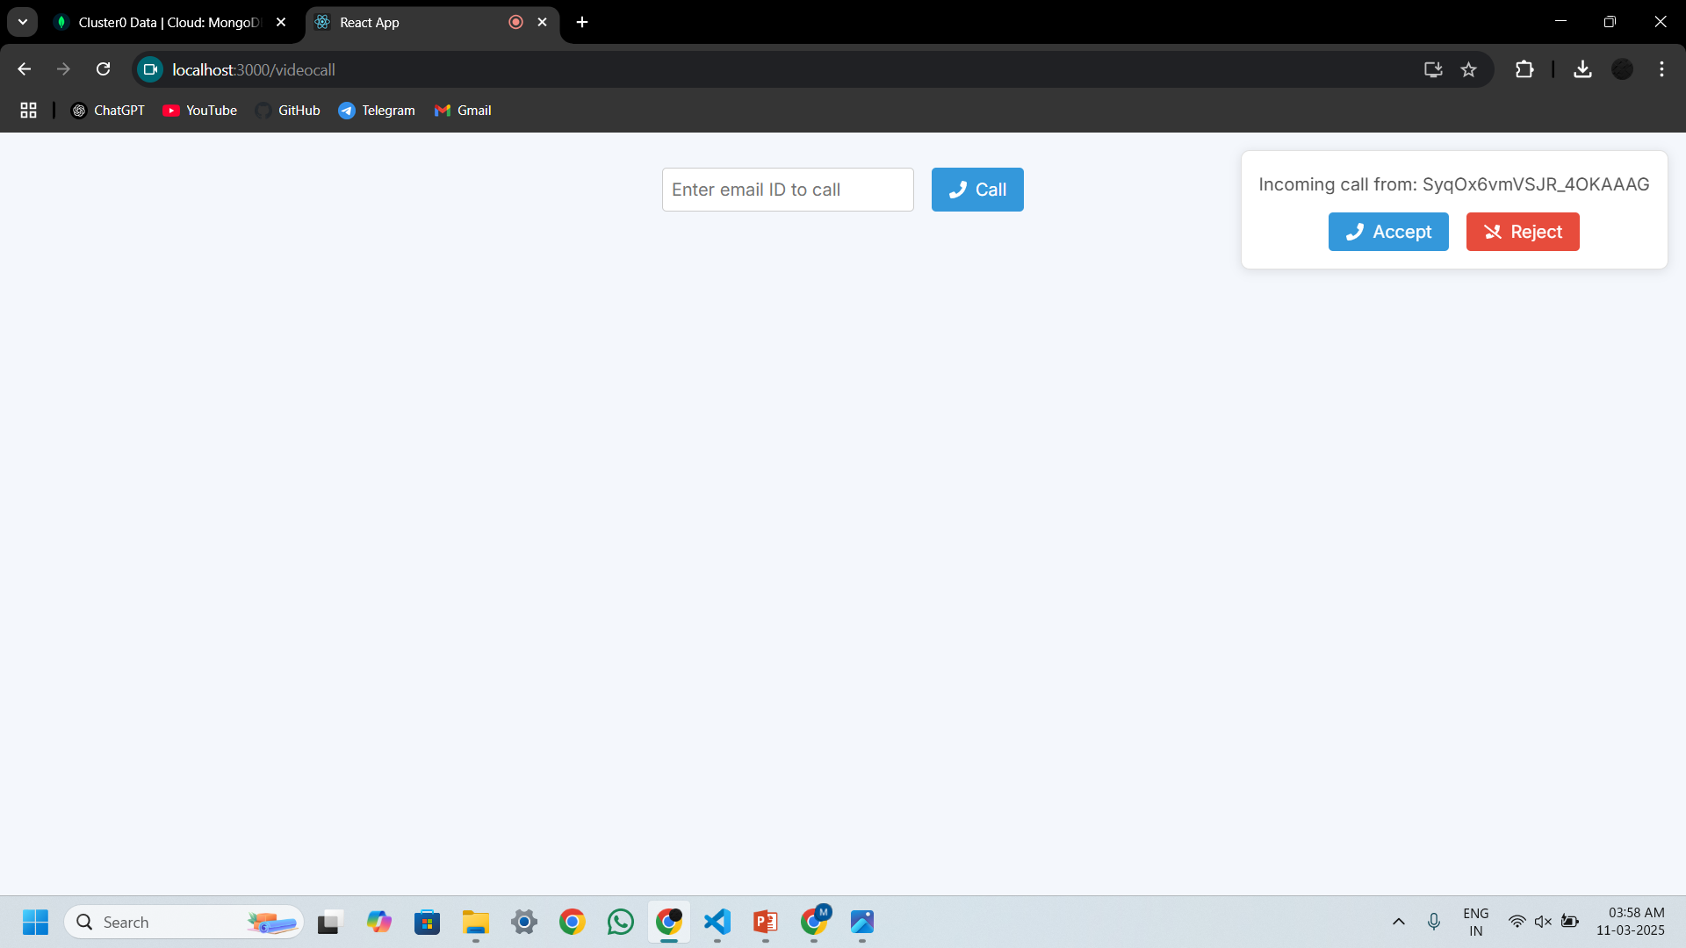
System Features - Video Calls

Slide 23
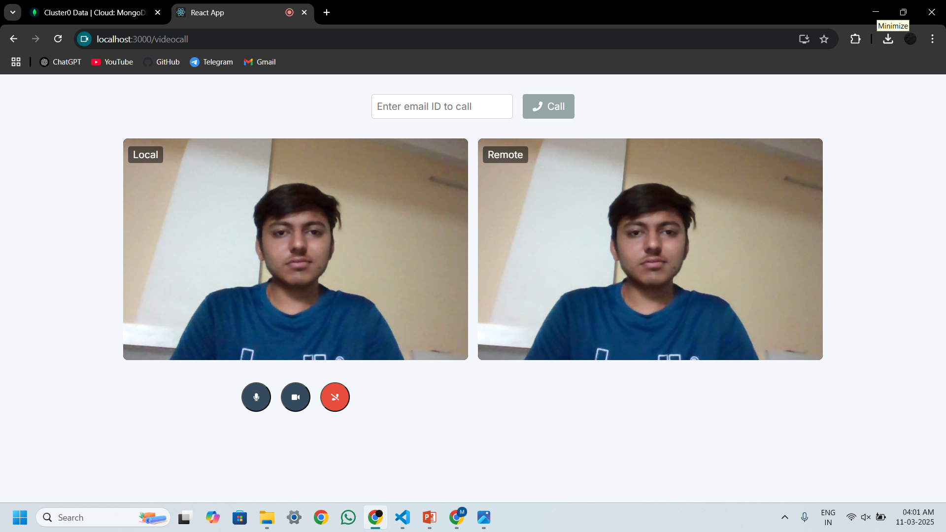
System Features - Video Calls

Slide 24
System Features – Task Management
The Task Management feature helps teams organize, assign, and track tasks efficiently.

Slide 25
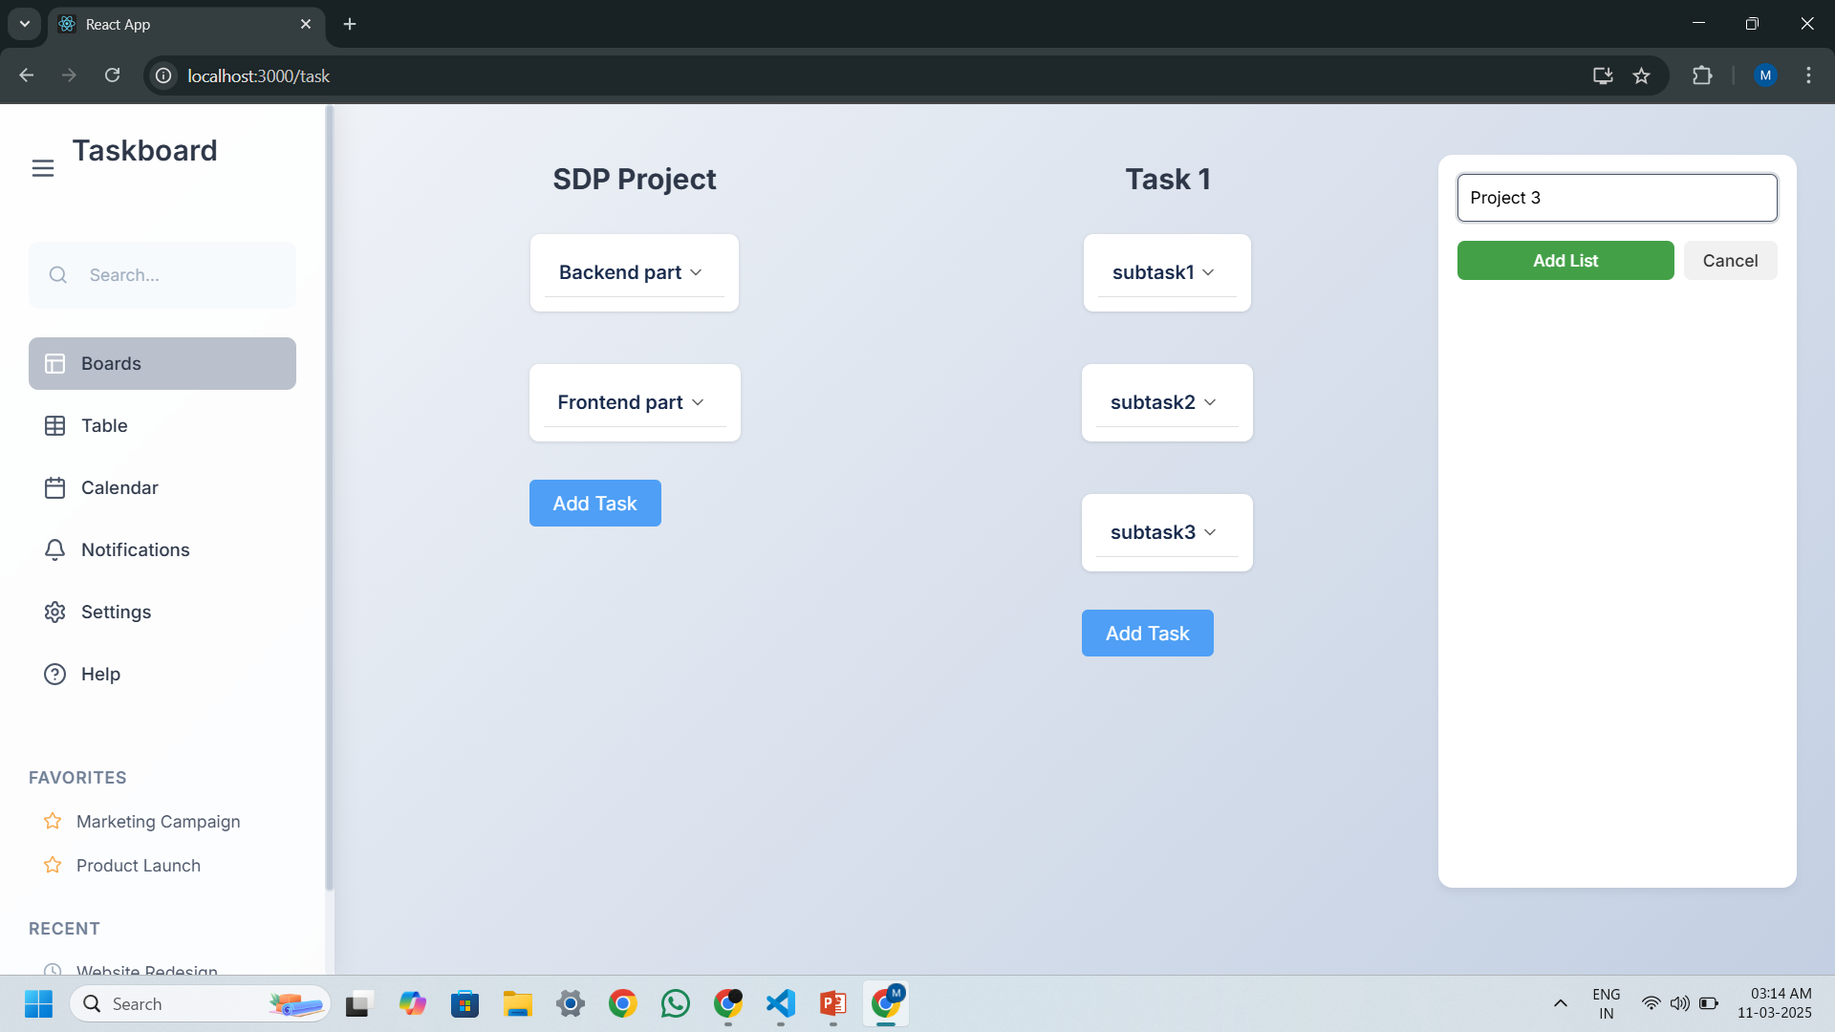
System Features – Task Management

Slide 26
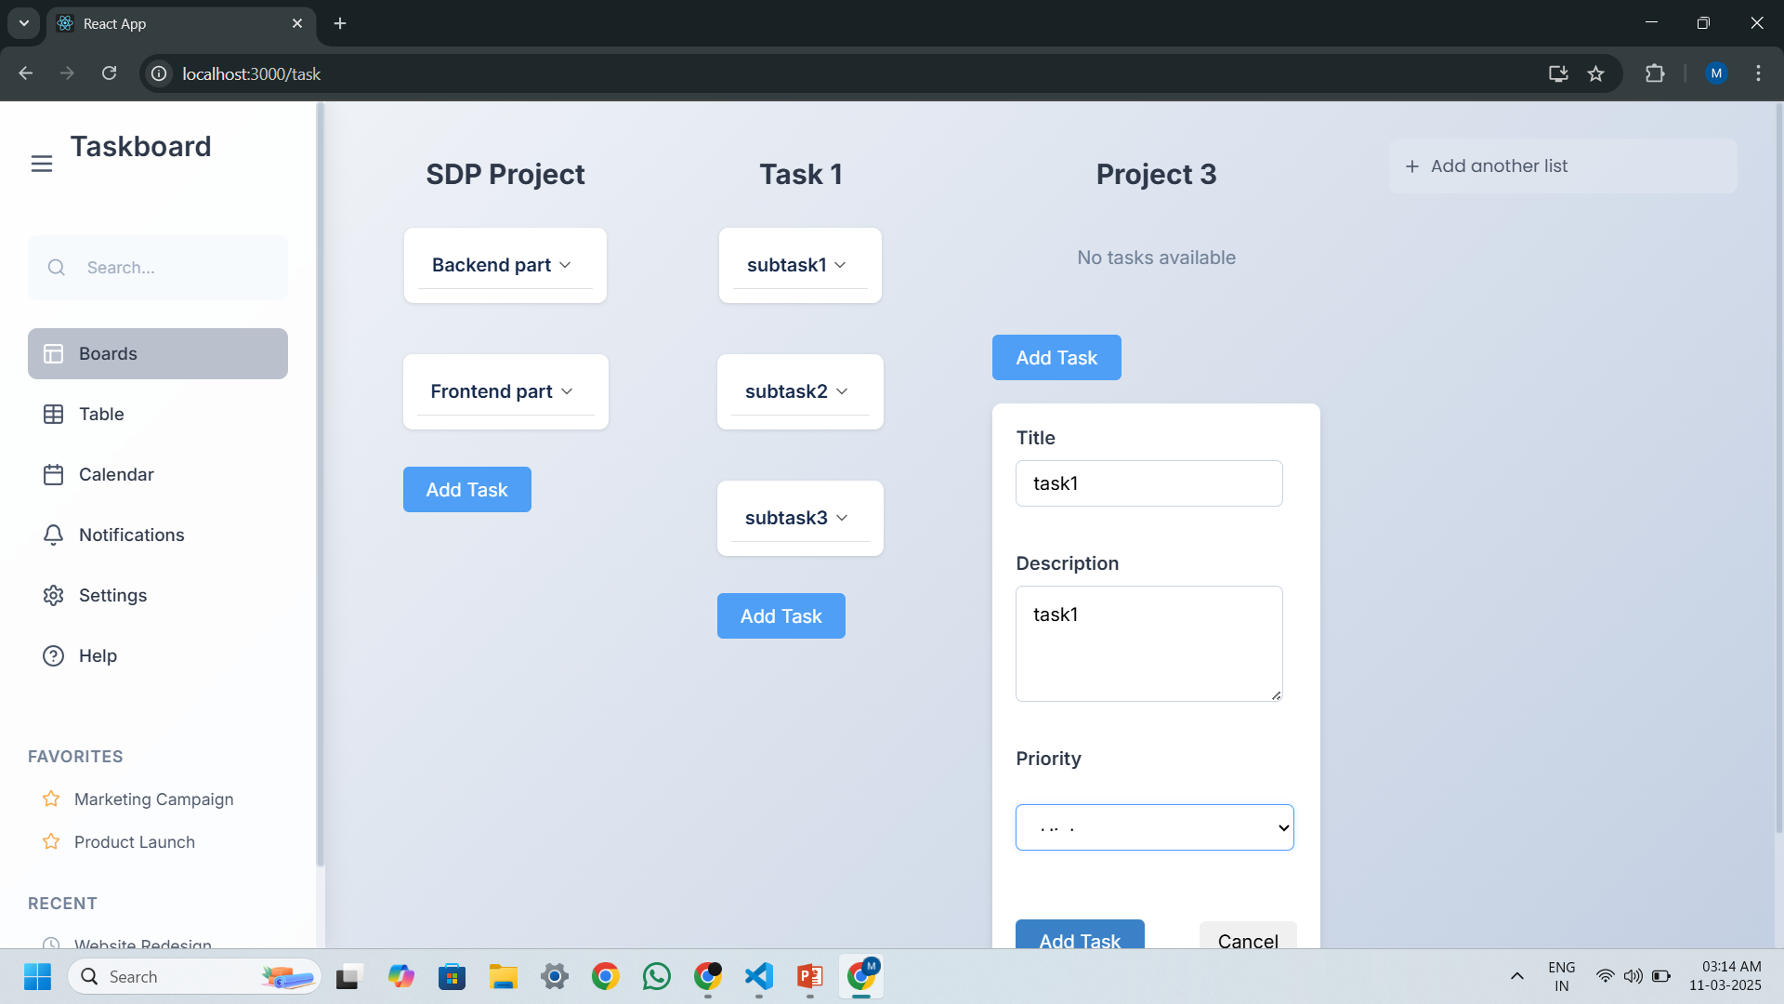
System Features – Task Management

Slide 27
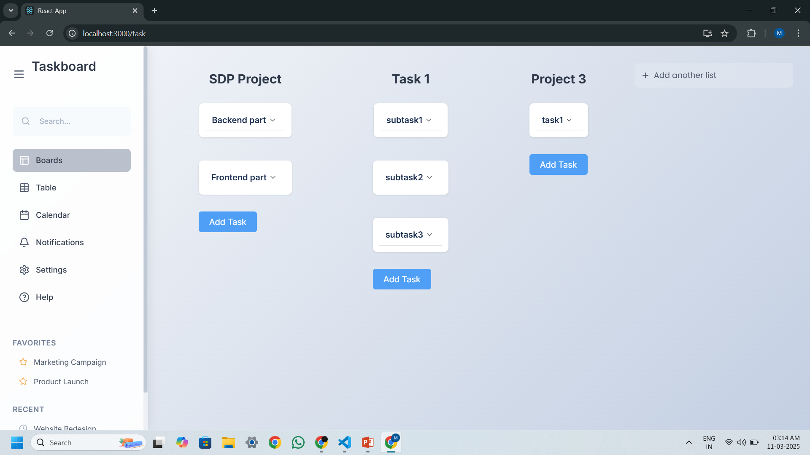
System Features – Task Management

Slide 28
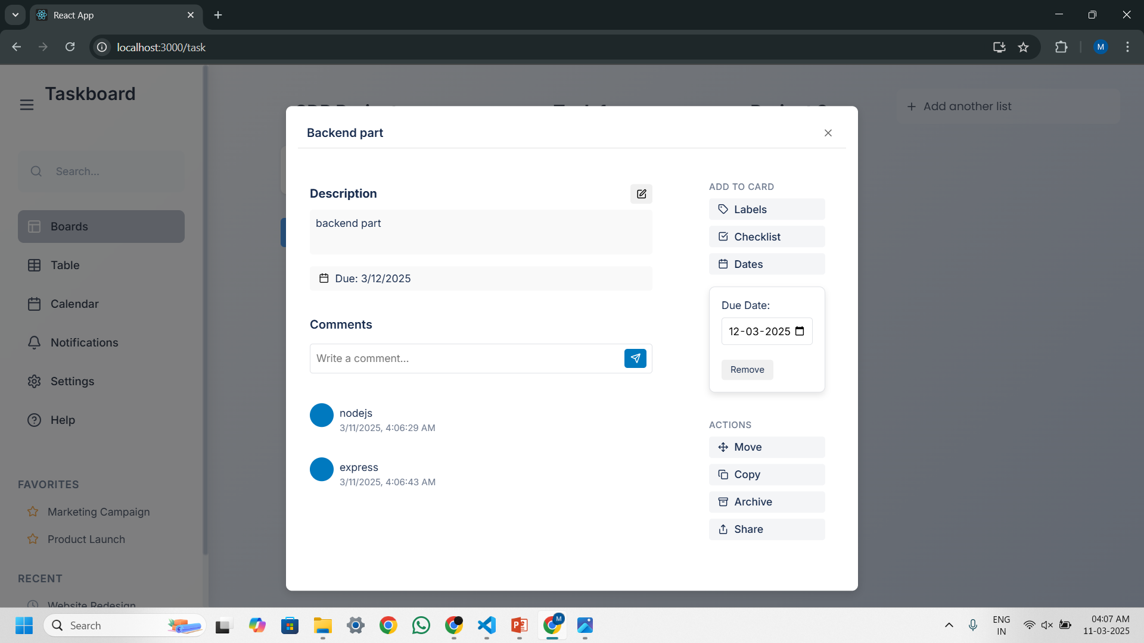
System Features – Task Management

Slide 29
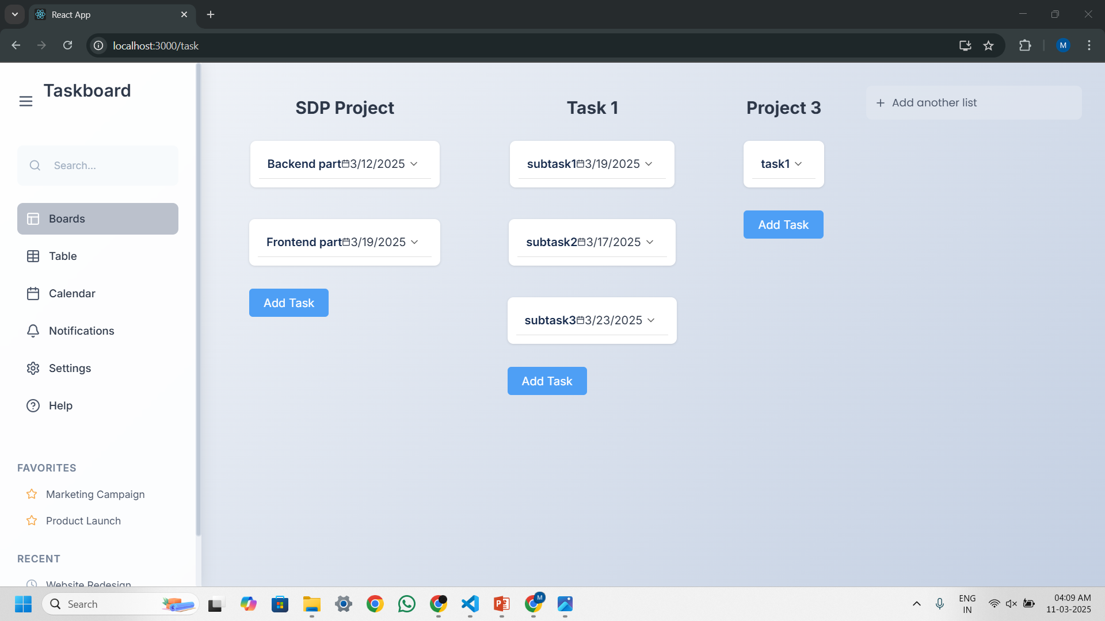
System Features – Task Management

Slide 30
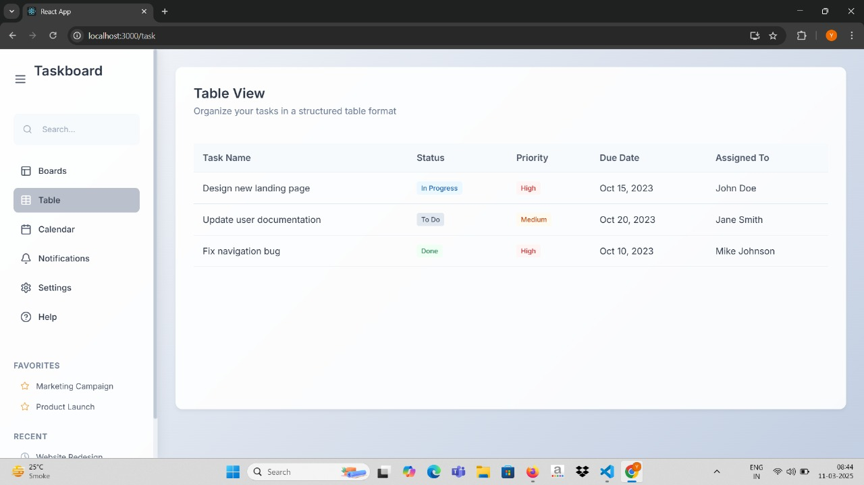
System Features – Task Management

Slide 31
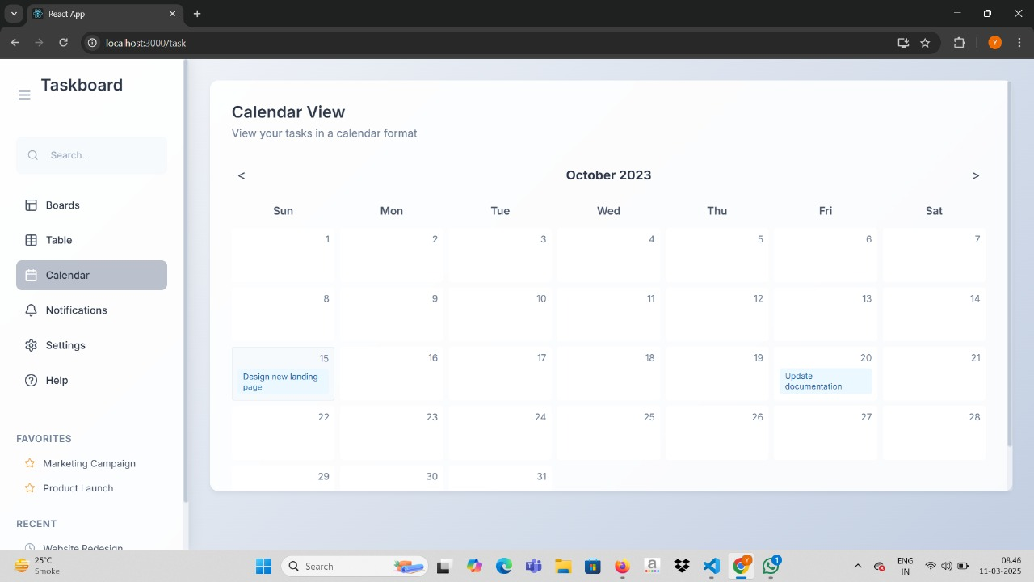
System Features – Task Management

Slide 32
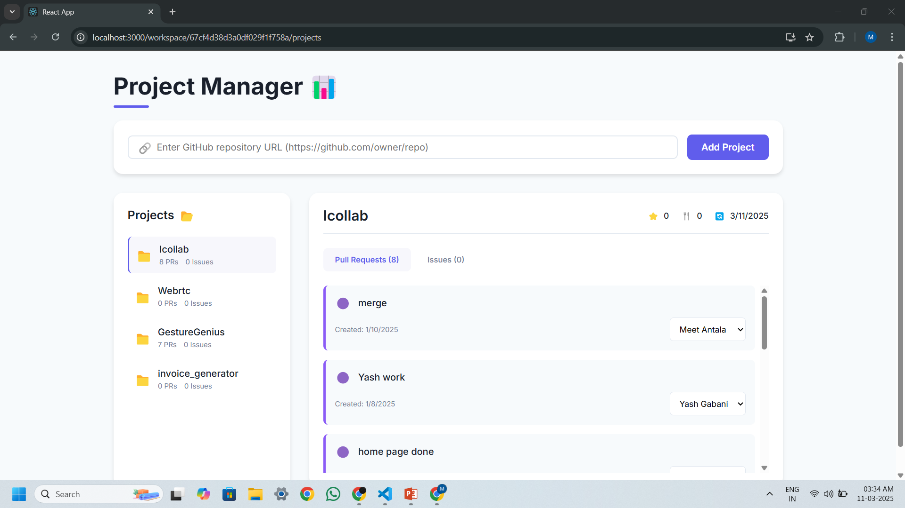
System Features – Integration of GitHub

Slide 33
System Features - AI-Based Message Summarization
Summarizes lengthy conversations for quick insights.
Helps users catch up on missed discussions.
Uses Natural Language Processing (NLP) to extract key discussion points.

Slide 34
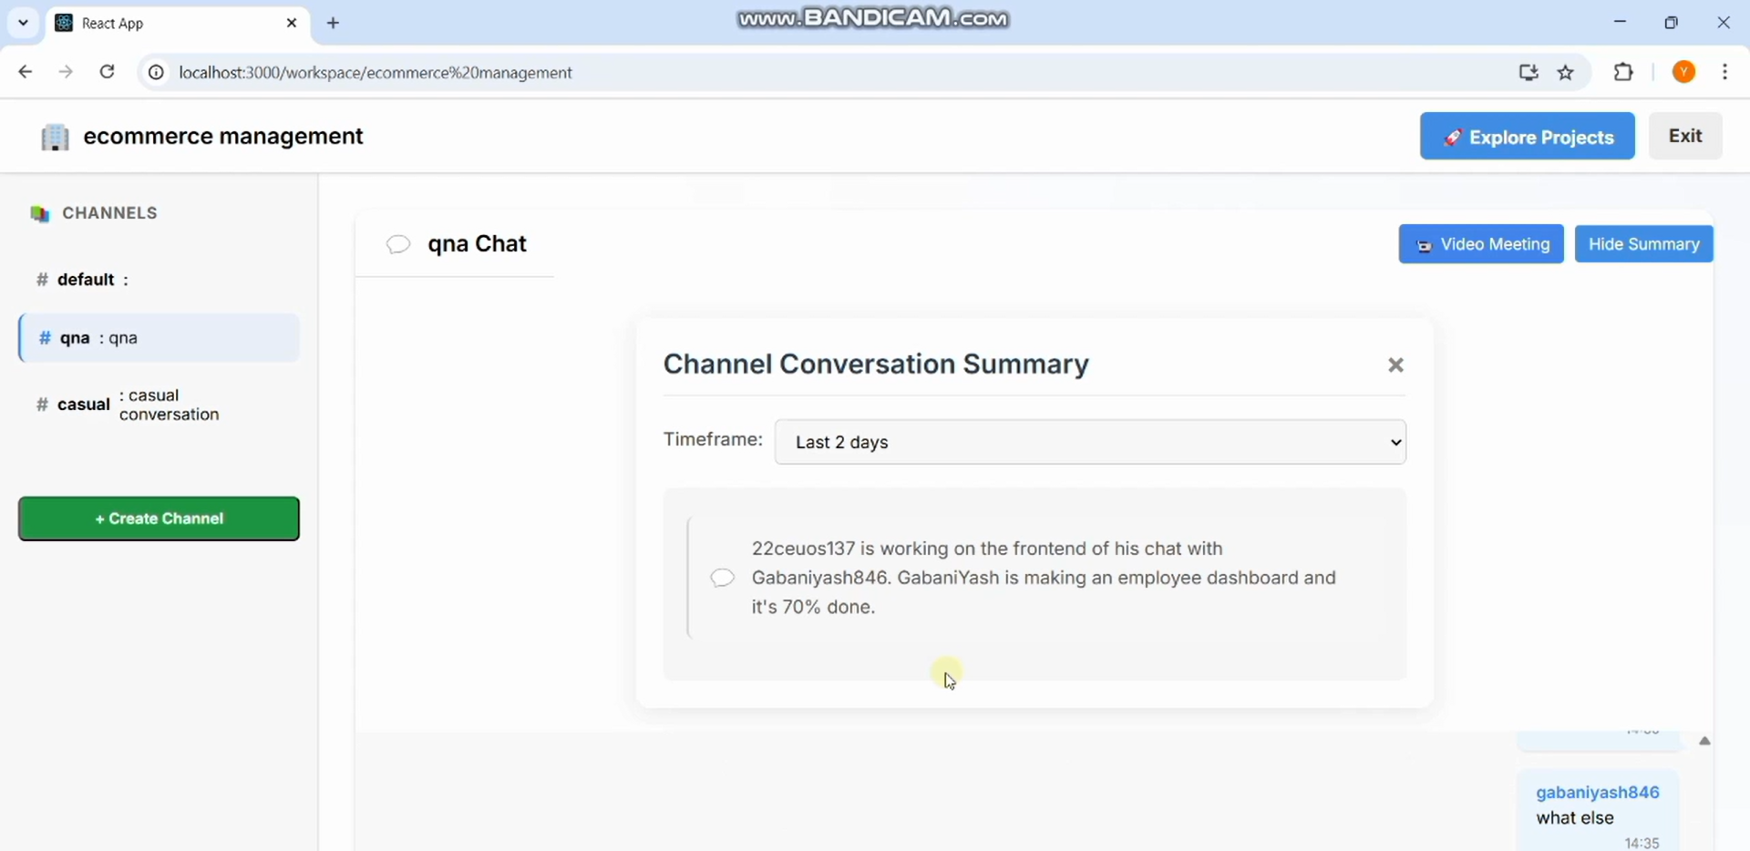
System Features - AI-Based Message Summarization

Slide 35
Technologies Used
Frontend: ReactJS (User Interface, Component-Based Architecture).
Backend: Node.js & Express.js (API & Server Logic).
Database: MongoDB (NoSQL database).
Real-time Communication: WebRTC & WebSockets for messaging and calls.
Third-Party Integrations: Google Drive, GitHub.

Slide 36
Future Enhancements
Chatbot Assistance – AI-powered chatbot to help users with FAQs.
Customizable Themes – Users can personalize workspaces.
Advanced AI Insights – Intelligent meeting summaries & automated task assignments.
Mobile App Support – Dedicated Android & iOS applications.

Slide 37
Conclusion
Icollab is a powerful collaboration tool designed for modern teams.
Workspaces & Channels help organize discussions.
Messaging and video calls improve communication.
AI-based summarization saves time and enhances productivity.
A promising solution for effective remote and hybrid teamwork.

Slide 38
Thank You!

